Slide 1
GME Coordinator Meeting
May 7, 2024

Slide 3
Wellness Committee Update

Slide 4
Annual GME Program Coordinator Awards
Many Thanks to: Mimi Gunning, Amanda Aprea, Dafny Argueta, Nikki DeMelo, and Olivia Ezekwelu
---------
Adept at fostering collaboration among busy fellows, program leadership, faculty, and other institutional administrators, maintaining a harmonious environment that enhances productivity and satisfaction.
Quick to identify problems and propose solutions; truly a rock star
Highly valued member of the team; committed to providing a supportive environment for the residents.
A true advocate for lifelong learning. The real glue that holds our program together.
In promoting diversity, equity, and inclusion make her an invaluable asset during the recruitment process, helping to create a welcoming atmosphere that supports all candidates, particularly those from under-represented backgrounds.

Slide 5
Annual GME Program Coordinator Awards
The ability to manage and coordinate complex tasks and responsibilities across various fellowship tracks, ensuring that everything from recruitment to evaluations is carried out efficiently, attests to her exceptional leadership.
Always available, always a team player, always looking out for the trainees.
A champion for fostering strong relationships among residents and between residents & faculty
Phenomenal work ethic. Simply put… unstoppable!
Worked the job of 2 individuals and supported residents and staff without missing a beat. Commitment to the wellbeing of residents and our education has been tireless.
Notes:
Caring for family members without missing a beat.

Slide 6
Annual GME Program Coordinator Awards
2024 Winners
Rising Star Award Winner: Shirley Cole
Program Coordinator Excellence Award Winner: Kelly Moutsioulis
GME Leadership and Service Award Winner: Ruth Colman
Help us celebrate and honor all award recipients on Mon, June 3rd from 4:30-6:30 in Leventhal as part of the Annual Education Week Kick Off Event

Slide 7
GME Orientation & Onboarding

Slide 8
Current Status of License Applications
184
152
34
2

Slide 9
Pre- Orientation
Remaining Tasks:
Follow up on missing addresses & phone numbers
Ensure all institutional DEA #s assigned (submit signed lists to GME & pharmacy)
Confirm Security Badge Access needs (notify GME of any changes from last year)
Ensure CRICO in place for all trainees (contact Ruthie Travers)
Provide Service Now submission information via GME central spreadsheet (to be shared)
Routinely Monitor onboarding checklists; follow up on missing items
Ensure completion of REQUIRED video modules assigned AFTER the checklists are complete (9 total; average length = 21 mins)
Detailed communication with ACLS/BLS links & GME appointment times to be sent to trainees

Slide 10
IT & Clinical Access Timeline
Programs Enter Data | Service Now Submissions | Hire Date | MyPath DUE
May 17-23 | May 24-31 | June 14 | June 21
June 3-9 | June 10-14 | July 1 | July 8
July 5-10 | July 11-17 | August 1 | August 8
Currently waiting for employee ID#s – will be uploaded to MedHub Demographics as soon as available.
IT welcome emails will be sent to the manager that is input on the Service Now request file.
Manager will then need to forwarding the individual login information to residents and fellows.
Clinical access will be granted upon successful completion of EPIC training.

Slide 11
Anticipated Fields Needed for Bulk Upload
Users to Mirror
Shared Drive Access
Assigned courses for EPIC
Employee ID#, NPI, License #, DEA# (pre-populated)
Access to additional departments
Anyone transferring from another role within BIDMC should be submitted as an individual Service Now ticket to either “Re-enable” or “Update” account access. This will be indicated on the central spreadsheet. These tickets should be submitted within 10 days of the transfer date.

Slide 12
EPIC Training
ALL New HIRE sessions are LIVE virtual sessions
Communication to be sent to program contacts ~24-48 hours before each training date with links to each specific class.
All classes are expected to start at 7AM (with exception of 7/1 & 8/1 classes)
Preparing for Virtual Training tip sheet to be emailed to all PCs
If not on BIDMC computer, must download Citrix for remote access
If testing out, must do so by noon the day before scheduled class. Test outs take ~ 10-15 mins. to complete.
User personalization labs, will be offered post-training as virtual self-paced modules.

Slide 13
Rotator Process for IT Account Access
IT access for Rotators will NOT be submitted centrally by GME due to rolling timelines. These should be submitted via individual Service Now tickets within a 10 day window of the anticipated start date.
Currently waiting on Workday profile creations and assigned contingent worker ID#s
Test outs are encouraged; once in Workday will have this option
If unable to test-out; manager will need to assign training (or trainee can self enroll)
Lahey Rotators – Service Now Request is all that is needed. EPIC access will be continuous. Does not require additional training or test outs. Submit Service Now “update access request” for shared drive, departmental apps, one-offs application needs, etc.
Service Now Form being revised. As of 5/29 may include additional fields to specifically indicate rotators from MGH & BCH (Tufts?). More to come on this.
90 day auto disable may be an issue – more to come on this.

Slide 14
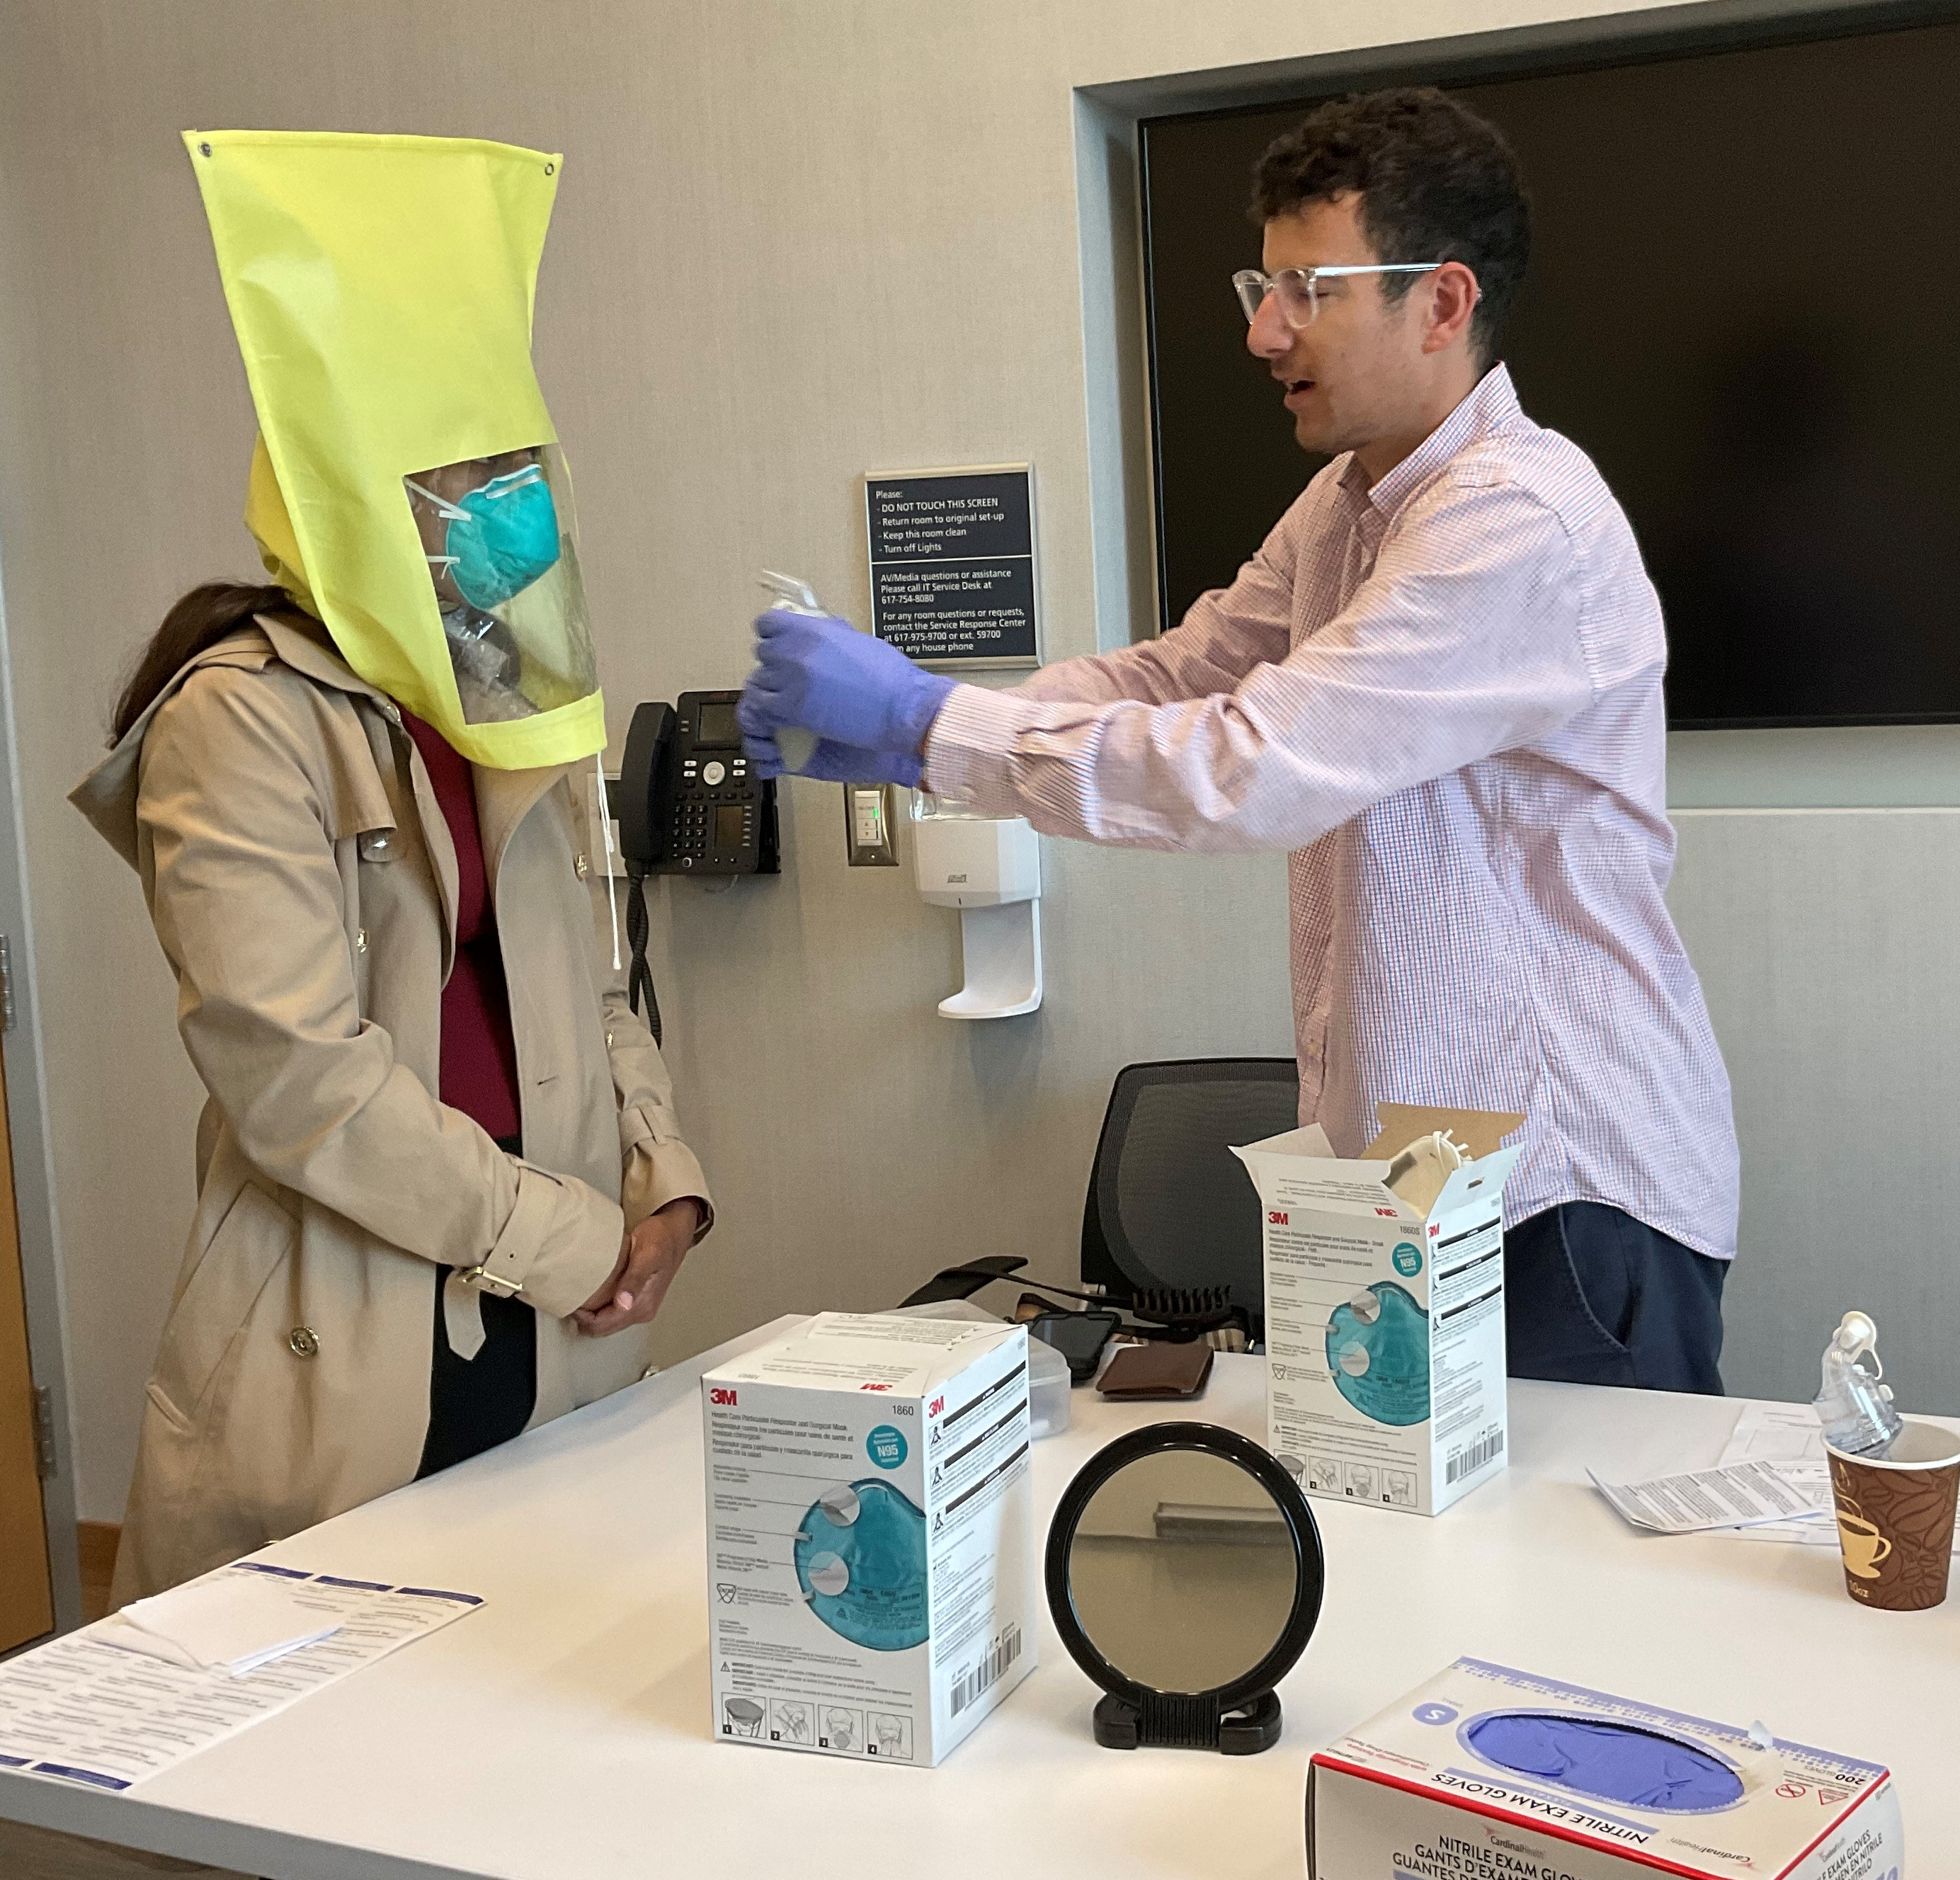
GME Institution Orientation - Day 1 (6/14; 7/1; 8/1)
Detailed GME/HR/Fit Testing Appointment times have been sent to Program Coordinators
Tips for a smooth process:
Adhere to assigned appointment times
Consider escorting trainees to/from Leventhal
Ensure all trainees have original I9 verification documents
MUST be clean shaven for Fit Testing!
Allow time for EPIC test outs (if applicable)

Slide 15
GME Institution Orientation Day 1 (6/14; 7/1; 8/1)
ACLS/BLS training has three components:
Part 1 – pre-orientation required modules; can take up to 4-5 hours; certificates need to be emailed to Olivia prior to 6/14 or brought as hard copies
Part 2 – required LIVE virtual Session on 6/14 (3PM-6PM)
Must have cameras ON
No driving
Must list full names for attendance purposes
Ensure private space with no distractions
Part 3 – skills tests on assigned days and times throughout the week

Slide 16
Post- Orientation
Remaining Tasks:
Follow-up RE institutional DEA submissions
Assign Required MyPath modules for trainee completion within 7 days of hire

Slide 17
Other/Misc
ACGME Milestone Window – April 22- June 28
PLAs – execute now for ‘24-’25 academic year
Exit Checklists

Slide 18
MedHub Training Sessions
MEDHUB PROGRAM LETTER AGREEMENT PROCESS
Date: May 14 at 9am-10am
Date May 23 at 1pm-2pm
MEDHUB ONBOARDING TRACKING
Date: May 8 at 1pm-2pm
Date: May 16 at 1pm-2pm
Date May 20 at 9am-10am
https://us02web.zoom.us/j/4131021897

Slide 19
Questions????

Slide 20
PC Wellness Committee Survey

