Slide 1
BIDMC Duty Hour
By: Alessandra Alvarez Hinojosa, GME Accreditation Program Manager

Slide 2
What months do they report on?
August
December
March

Slide 3
When do these evaluations go out?
1st of September
1st of January
1st of April
Deadline: 2 weeks to complete it

Slide 4
What you can do?
Complete accurate schedule activity for these months
Submit LOA, Vacations, Sick etc
Reminder your residents/fellows

Slide 5
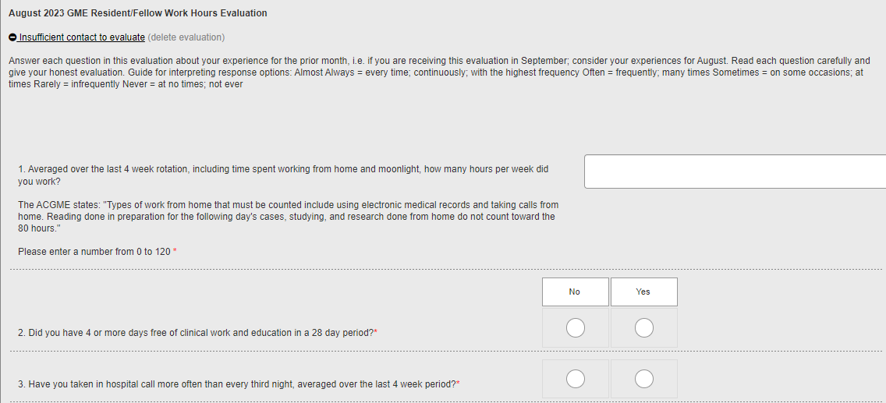

Slide 6
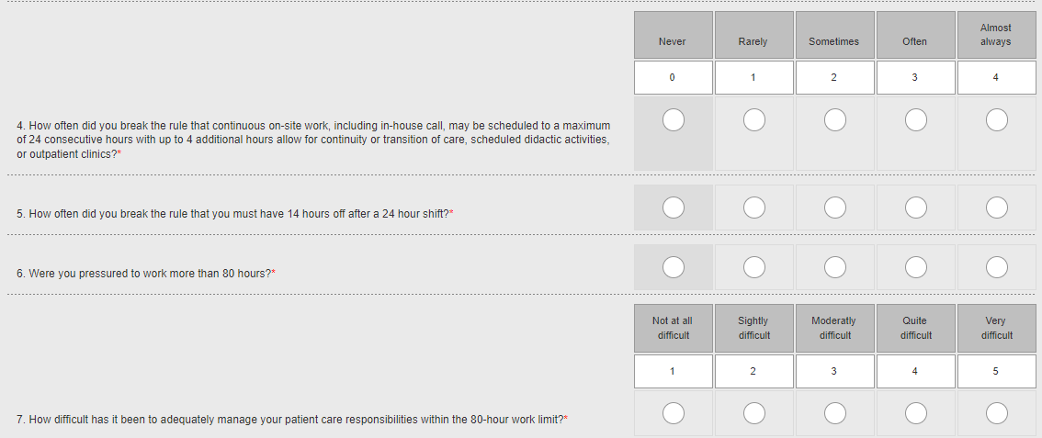

Slide 7
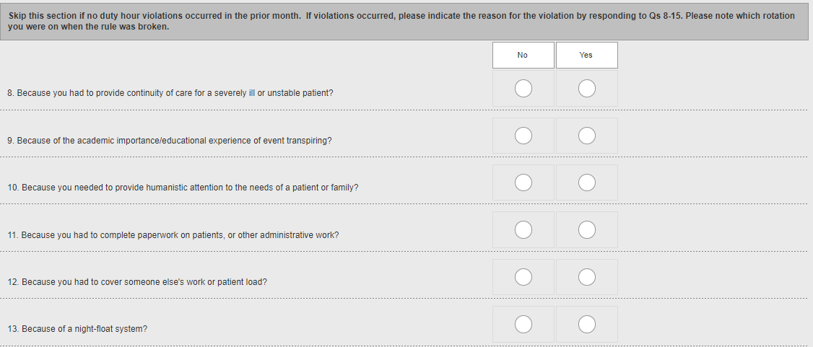

Slide 8
